Slide 1
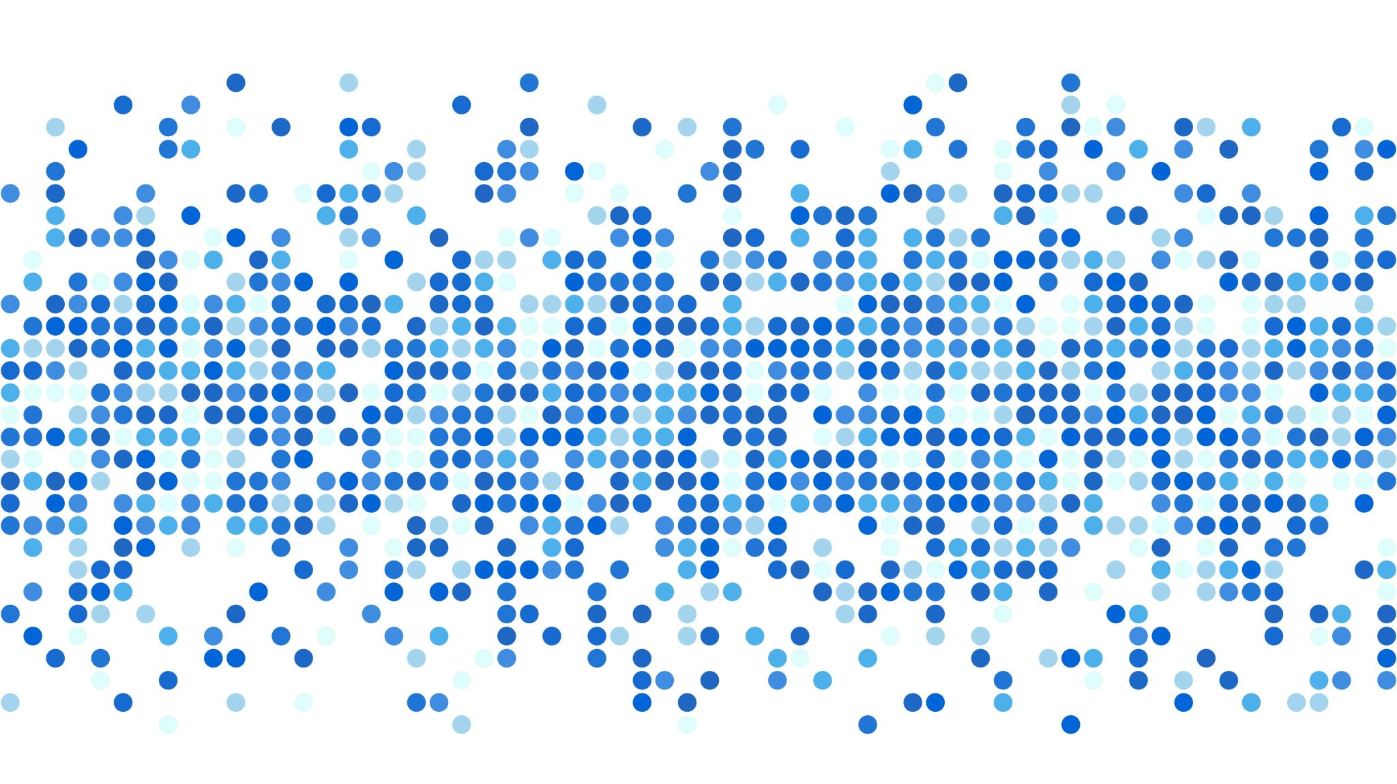
function
Unit 5

Slide 2
function – make your code modular
Function are a group of code, which normally accomplish a specific target.
When needed you can call/invoke the function, to run the code.
Separate your code into many functions, each one do a specific task, this makes your code modular, and easy to understand, easy for maintain.

Slide 3
Function declare and call
// declare function
function func_name(arg1, arg2, …, argN) {
// statement(s);
}
// call function
func_name(val1, val2, … );
Use keyword `function` to declare a function.
The actual code for the function to execute are enclosed in `{}`
When need to execute the function, or to say: call/invoke the function, directly use the function name with `()` in statement.
If function does not have return, then the return value is undefined.
Excess values when call will be ignored. If less values then last few args will be undefined.

Slide 4
Default value
// declare function
function func_name(arg1, arg2, …, argN=value) {
// statement(s);
}
// call function
func_name(val1, val2, … );
Any position can have default value.
If no actual parameter passed when call the function, the argument will take default value. If have will take the actual parameter.

Slide 5
Rest parameter
// declare function
function func_name(arg1, arg2, …argN) {
// statement(s);
}
// call function
func_name(val1, val2, … );
Last argument was proceeded with three dot. This take any number of parameters from caller.
Can iterate over this argument and get each item out of it.

Slide 6
Anonymous function, function expression
// declare function
let variable_name = function (arg1, arg2, …, argN) {
// statement(s);
};
// call function
variable_name(val1, val2, … );
Can declare a function with no function name.
Can assign this anonymous function to a variable name.
Then can use this variable name same as a function name to make function call.
Can pass this new declared anonymous function as parameter.
Only use after the function expression.

Slide 7
Lambda function (arrow function)
// declare function
let variable_name = (arg1, arg2, …, argN) => {
// statement(s);
};
let variable_name = (arg1, arg2, …, argN) => statement;
// call function
variable_name(val1, val2, … );
It can be one libe lambda expression, or multiline lambda block. It is similar to anomymous function.
Also can assign it to a variable_name, use as parameter.

Slide 8
Immediately invoked function expression
// declare function
(function func_name (arg1, arg2, …, argN) {
// statement(s);
}) (param1, param2, …, paramN);
Define a function and immediately call it.
The func_name is only scoped inside this block, can not use it outside. (undefined)

Slide 9
recursion
When a function calls to itself, or function calls to others but finally calls back to itself, this is called recursion.
Need avoid infinite loop in recursion.
Recursion can help to solve certain problem with very clear code.
Anonymous function can be defined and called; it is called Anonymous Recursive Function.

